Slide 1
Lecture 1 Reviewing
Digital Signals and Systems

Slide 2
Digital signals and system
A/D and D/A
The Z-transform

Slide 3
Digital Signal and system
Typical digital signals
Operation of digital signals
The mean power of a discrete signal
Properties of digital signals
Convolution (Input, System, Output)
Stability
Causality
Representation of digital signals and system in frequency domain
Autocorrelation and cross correlation

Slide 4
Digital Signal and system
10. Analog-Digital(A/D) converter
This conversion is called digitization.
It consists of sampling and quantization.
of the signal into a finite number of bits.
Why digitization? Computer, algorithm
(1) sampling frequency; (2) quantization
11. Digital-Analog(D/A) converter
It converts the digital signal into an analog
signal.

Slide 5
Digital Signal and system
12. The z-Transform
(1) Definition
(2) The z-Transform of typical digital signals
(3) The Inverse z-Transform
A. Long Division
B. Partial Fraction Expansion
(4) Properties of z-Transform
(5) Stability

Slide 6
Digital Signal
Typical digital signals

Slide 7
Digital Signal
Typical digital signals

Slide 8
Digital Signal
Typical digital signals

Slide 9
Digital Signal
Typical digital signals

Slide 10
Digital Signal
2. Operation of digital signals

Slide 11
Digital Signal
3. The mean power of a discrete signal

Slide 12
Digital Signal and system
4. Properties of digital signals

Slide 13
Digital Signal
5. Convolution

Slide 14
Digital Signal
5. Convolution

Slide 15
Digital Signal
5. Convolution
Convolution algorithm:

Slide 16
Digital Signal
5. Convolution
For example,

Slide 17
Digital Signal
6. Stability

Slide 18
Digital Signal
7. Causality

Slide 19
Digital Signal
8. Representation of digital signals and system in frequency domain
DFT

Slide 20
Digital Signal
8. Representation of digital signals and system in frequency domain

Slide 21
Digital Signal
8. Representation of digital signals and system in frequency domain

Slide 22
Digital Signal
9. Autocorrelation and cross correlation

Slide 23
Digital Signal
9. Autocorrelation and cross correlation
An example for cross-correlation calculation.

Slide 24
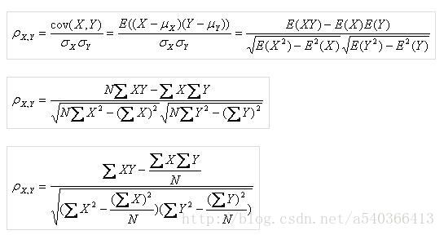
Pearson Correlation Coefficient

Slide 25
Digital Signal
10. Analog-Digital(A/D) converter
This conversion is called digitization.
It consists of sampling and quantization.
of the signal into a finite number of bits.
Why digitization? Computer, algorithm
(1) sampling frequency; (2) quantization

Slide 26
Digital Signal
10. Analog-Digital(A/D) converter

Slide 27
Digital Signal
10. Analog-Digital(A/D) converter

Slide 28
Digital Signal
11.

Slide 29
Digital Signal
12. The z-Transform
(1) Definition

Slide 30
Digital Signal
(2) The z-Transform of typical digital signals

Slide 31
Digital Signal
(2) The z-Transform of typical digital signals

Slide 32
Digital Signal
(3) The Inverse z-Transform
A. Long Division
B. Partial Fraction Expansion

Slide 33
Digital Signal

Slide 34
Digital Signal

Slide 35
Digital Signal
Partial Fraction Expansion

Slide 36
Digital Signal
(4) Properties of z-Transform

Slide 37
Homework 1
编写卷积和互相关计算程序。分别输入一对数字信号序列，用图表示卷积和互相关计算结果。

Slide 38
Thanks a lot !

